Slide 1












INFORMATION AND COMMUNICATION TECHNOLOGIES

Slide 2

INTRODUCTION

Slide 3


INTRODUCTION
Information and Communication Technologies (ICT) refer to the diverse set of technologies utilized for the acquisition, storage, processing, and dissemination of information. This encompasses hardware, software, networks, and the internet. In modern society, the importance of ICT cannot be overstated. It serves as the backbone of digital transformation, enabling seamless communication, efficient data management, and innovative solutions across various sectors. ICT plays a pivotal role in enhancing connectivity, productivity, and accessibility to information, thereby contributing significantly to economic development, education, healthcare, and overall societal progress. Embracing and leveraging ICT has become integral to staying competitive and fostering advancements in our rapidly evolving digital landscape.

Slide 4

CORE TECHNOLOGIES
IN ICT

Slide 5


CORE TECHNOLOGIES IN ICT
Core technologies in Information and Communication Technologies (ICT) encompass hardware, networking, software, applications, and internet connectivity. Hardware and networking form the infrastructure backbone of ICT, involving devices like servers, routers, switches, and the underlying networks that facilitate data transfer. Software and applications, on the other hand, constitute the intelligence of ICT, encompassing operating systems, productivity tools, and specialized applications tailored to various needs. The internet and connectivity act as the glue binding these components, allowing global communication, data sharing, and access to a vast array of information. Together, these core technologies synergize to create a robust ecosystem that powers the digital advancements shaping our modern world.

Slide 6

GOOGLE
SERVICES

Slide 7
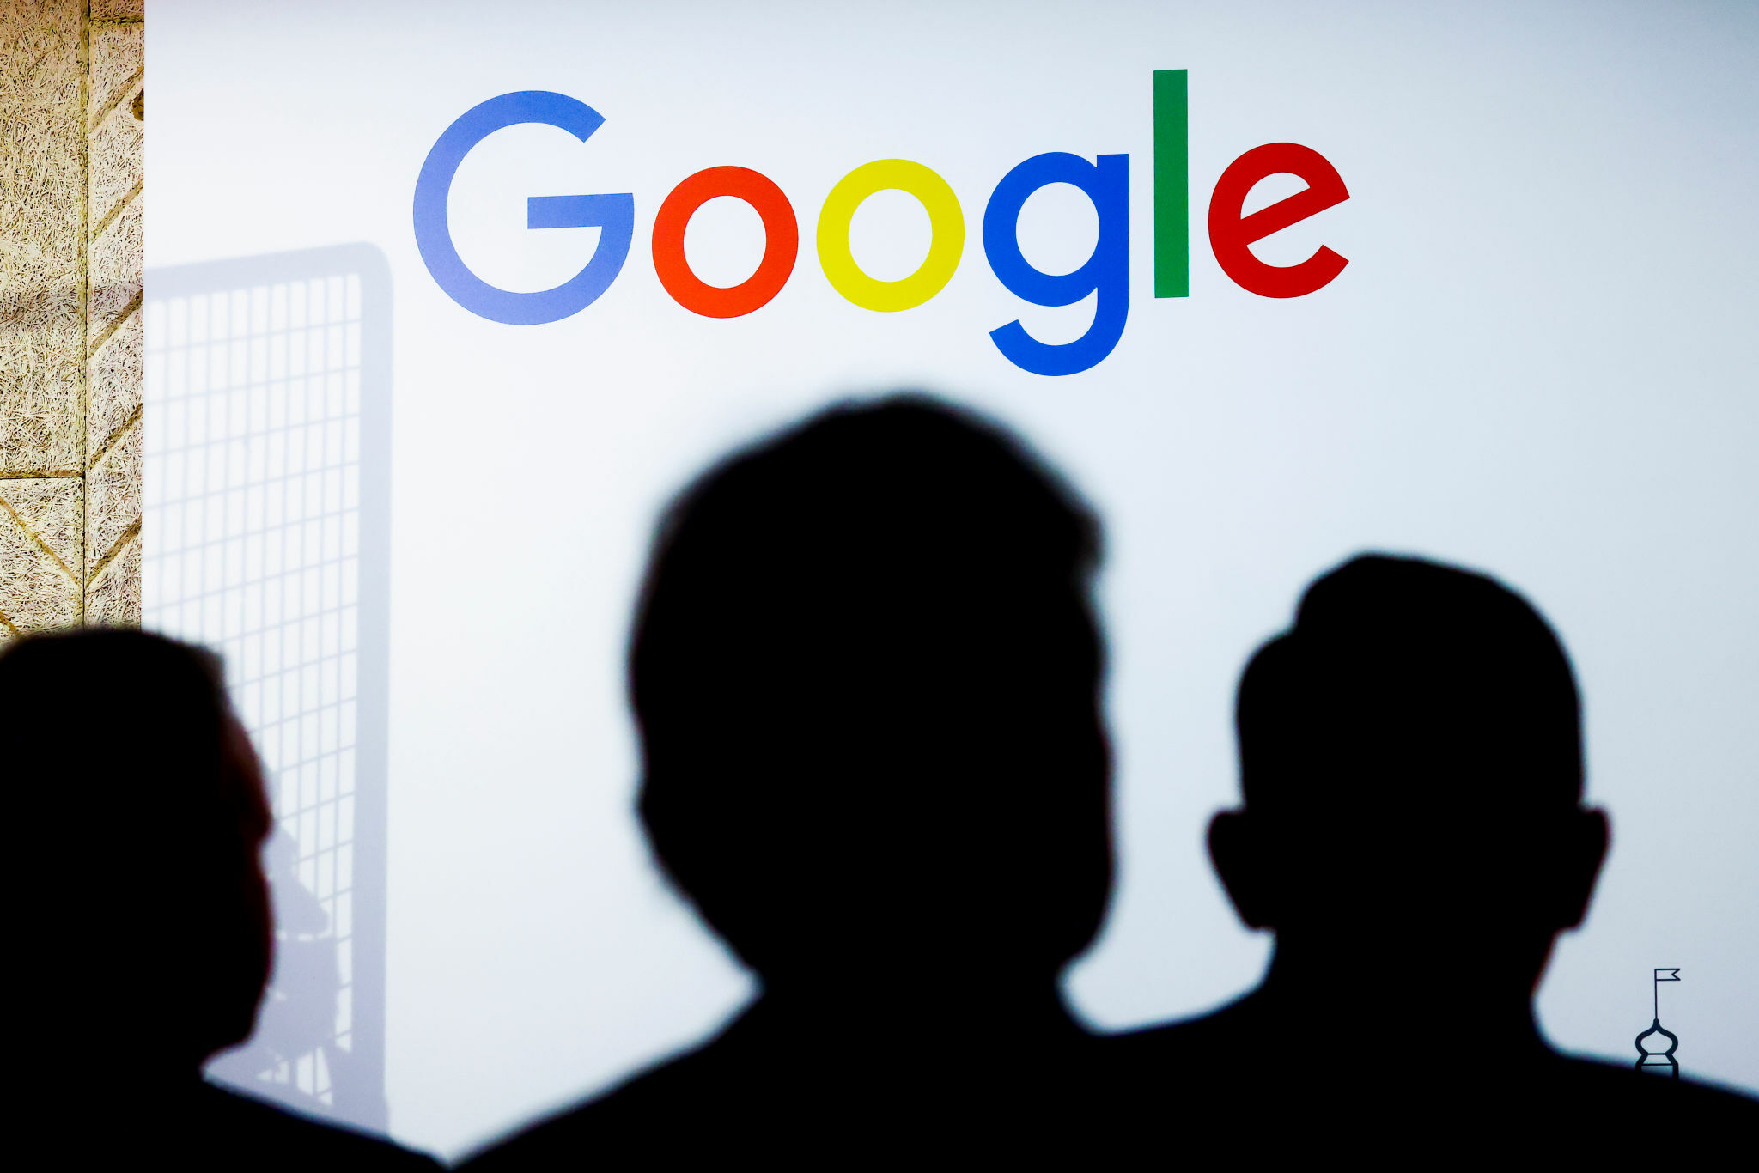

GOOGLE SERVICES
Introduction to Google Services brings us into a realm of innovative and widely-used digital tools provided by Google. These services have become integral in our daily lives, offering a seamless and interconnected digital experience. Google Search, a cornerstone service, revolutionized information retrieval, making knowledge accessible with a simple query. Gmail, a leading email platform, streamlined communication, while Google Workspace provided collaborative tools for businesses and teams. Google's impact extends further with Android, the world's most widely used mobile operating system. These services collectively reflect Google's commitment to facilitating information access, communication, and productivity, contributing significantly to the digital landscape.

Slide 8
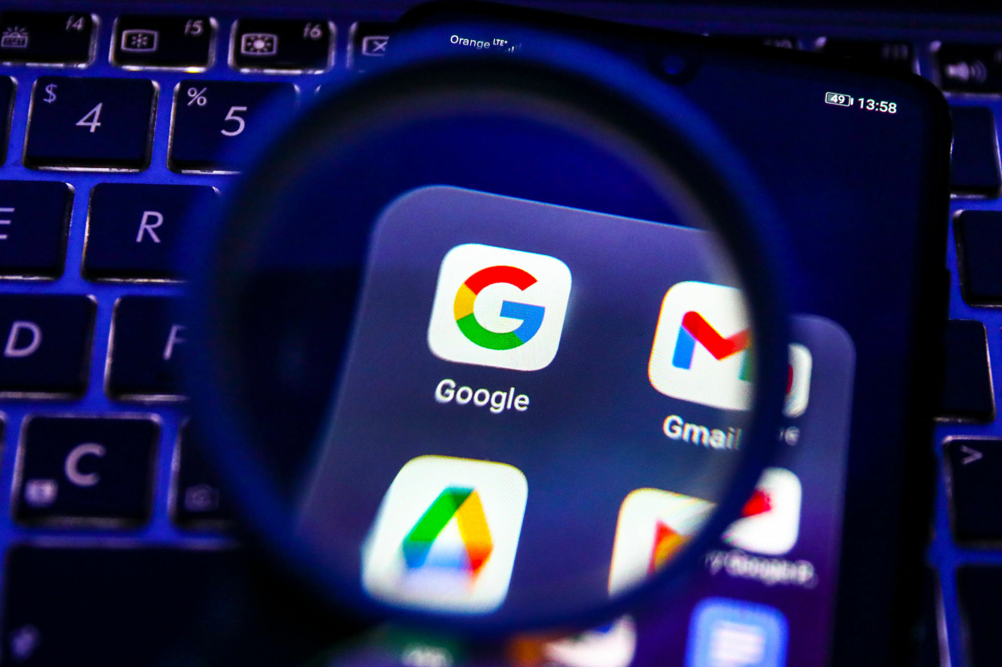







EXAMPLES OF GOOGLE SERVICES
Google Maps :
- Google Maps is a navigation and mapping service offering real-time directions, traffic updates, and location information, enhancing travel and exploration experiences.
Google Sheets :
- Google Sheets is a cloud-based spreadsheet tool for creating, editing, and collaborating on data, fostering efficient organization and analysis.
Google Drive :
- Google Drive is a cloud storage service enabling users to store, access, and share files seamlessly across devices.
Gmail :
- Gmail is a popular email service providing a user-friendly interface, efficient communication features, and ample storage capacity.
Google Translation :
- Google Translate is a language translation service, using machine learning for instant translations and breaking language barriers.
Google Meet :
- Google Meet is a video conferencing platform facilitating virtual meetings and collaborative discussions with features like screen sharing
and real-time captions.
In short, Google's suite of services, from Maps and Sheets to Drive, Gmail, Translate, Meet, and more, embodies technology's role in simplifying tasks, enhancing collaboration, and connecting people globally.

Slide 9

MICROSOFT

Slide 10


MICROSOFT
Microsoft Corporation, established in 1975, stands as a technological juggernaut with a far-reaching impact on the industry. At its core, Microsoft is synonymous with the Windows operating system, an integral part of personal computing for decades. Complementing this, Microsoft Office has become a household name, providing indispensable tools like Word, Excel, and PowerPoint for productivity.
In the realm of cloud computing, Microsoft Azure takes center stage. Azure offers a comprehensive platform that empowers businesses to build, deploy, and manage applications globally. This diversification reflects Microsoft's adaptability and commitment to staying at the forefront of technological advancements.
Microsoft's hardware ventures, notably the Surface line, exemplify innovation in the form of 2-in-1 devices, blurring the lines between laptops and tablets. This holistic approach, integrating software and hardware seamlessly, exemplifies Microsoft's commitment to providing integrated solutions that cater to evolving user needs. In summary, Microsoft's enduring influence in personal computing, its trailblazing efforts in cloud services, and its hardware innovations collectively underscore its status as a pivotal force shaping the technology landscape..

Slide 11






MICROSOFT TOOLS
There are many Microsoft tools, including Microsoft Word, Excel, PowerPoint, and Outlook, which are essential components of Microsoft Office, which is a suite of productivity programs.
Microsoft Word :
Word is a word processing application used to create, edit, and format documents. It is widely used for tasks such as writing letters, reports, and articles.
Microsoft Excel :
Excel is a spreadsheet program designed to analyse, calculate, and visualize data. It is useful for creating tables, graphs and managing digital information.
Microsoft PowerPoint :
PowerPoint is a presentation program that allows you to create slide shows for business, educational or creative purposes. It allows users to combine text, images and multimedia to convey ideas effectively.
Microsoft Outlook :
Outlook is an email client that also includes a calendar, task manager, and contact manager. It is used for managing emails, scheduling appointments, and organizing personal information.
Together, these applications cater to diverse needs, facilitating efficient document creation, data management, presentation development, and communication.

Slide 12

GIT

Slide 13


GIT
Git, conceived by Linus Torvalds in 2005, has fundamentally reshaped the landscape of collaborative software development. As a distributed version control system, Git provides a decentralized framework where each developer maintains a complete copy of the project's repository, ensuring autonomy and flexibility in coding workflows. This not only facilitates seamless collaboration but also minimizes conflicts, a common challenge in concurrent coding environments.
A standout feature of Git is its robust branching and merging capabilities. Developers can create isolated branches for specific features or tasks, fostering independent development. The subsequent merging of branches ensures a harmonious integration of changes back into the main codebase, facilitating an organized and systematic development process. This modular approach allows teams to concurrently work on diverse features without compromising overall code stability.
The commit-based model of Git offers a meticulous record of project history, enabling developers to track changes and understand the evolution of the codebase. This feature proves invaluable in debugging and maintaining a stable codebase over time. In essence, Git's versatility, from its decentralized structure to its powerful branching model, positions it as an indispensable tool for modern software development teams seeking efficient and collaborative workflows.

Slide 14

GITHUB

Slide 15


GITHUB
GitHub, founded in 2008, stands as a leading platform for version control and collaborative software development. At its core, GitHub utilizes Git, providing a centralized space for developers to host, share, and collaborate on projects. This platform plays a pivotal role in facilitating distributed workflows, allowing teams to work seamlessly across geographies. GitHub's user-friendly interface and robust features, such as pull requests, issues tracking, and collaborative code reviews, have made it a cornerstone for open-source projects and proprietary developments alike.
One of GitHub's key strengths lies in its social coding aspect. Developers can fork repositories, make changes, and propose these changes back to the original project through pull requests. This fosters a collaborative ecosystem where developers can contribute to projects they find interesting or align with their expertise. GitHub's repository hosting services, coupled with its vibrant community, have turned it into a hub for knowledge sharing, code improvement, and collaborative innovation.
Furthermore, GitHub Pages, a feature of GitHub, enables developers to host static websites directly from their repositories. This seamless integration allows for the easy deployment of documentation, project websites, or personal blogs, enhancing the accessibility of information related to a project. GitHub's influence extends beyond version control, transforming it into a multifaceted platform that empowers developers and teams to build, share, and iterate on code collaboratively.

Slide 16

CHALLENGES IN ICT

Slide 17


CHALLENGES IN ICT
Implementing Information and Communication Technology (ICT) in various sectors comes with its set of challenges. One common obstacle is the initial resistance to change among stakeholders. Users may be accustomed to traditional methods, leading to reluctance in adopting new technologies. Additionally, financial constraints often pose a challenge, as acquiring and implementing ICT infrastructure can be costly. Another issue is the rapid pace of technological advancements, making it challenging for organizations to keep up with the latest innovations.
To overcome these challenges, organizations can employ several strategies. First and foremost, fostering a culture of change and providing comprehensive training programs can mitigate resistance among users. Allocating budgets strategically and seeking cost-effective solutions can address financial constraints. Moreover, adopting scalable and flexible ICT solutions ensures adaptability to evolving technologies. Regularly updating policies and procedures to align with technological advancements helps organizations stay ahead in the dynamic ICT landscape. In essence, a proactive and strategic approach is key to successfully navigating and overcoming the challenges associated with ICT implementation.

Slide 18

FUTURE TRENDS IN ICT

Slide 19


FUTURE TRENDS IN ICT
The future of Information and Communication Technologies (ICT) is poised for dynamic shifts with several emerging trends. Artificial Intelligence (AI) is set to revolutionize industries through advanced automation and personalized user experiences. The Internet of Things (IoT) is fostering seamless data exchange among interconnected devices, while 5G technology promises faster and more reliable connectivity. Blockchain technology is reshaping sectors like finance with secure and transparent transactions. Quantum computing, AR, and VR are opening new frontiers in computational power and immersive experiences. Edge computing facilitates faster data processing, and cybersecurity innovations ensure robust protection against evolving threats. Biometric authentication, smart cities, RPA, and sustainable ICT practices are among the trends shaping the digital landscape. The future holds promise for transformative technologies that will redefine the way we live, work, and interact.

Slide 20

CONCLUSION

Slide 21


CONCLUSION
In conclusion, Information and Communication Technologies (ICT) stand at the forefront of transformative change, shaping the way we interact, communicate, and conduct business in the modern world. The ever-evolving landscape of ICT, marked by trends like AI, IoT, and 5G, promises unprecedented possibilities for innovation and connectivity. As these technologies converge, they create a dynamic ecosystem that not only enhances efficiency and productivity but also presents new challenges that require strategic solutions. The continued integration of emerging ICT trends holds the key to unlocking immense potential across various industries, paving the way for a future where connectivity, automation, and data-driven decision-making play central roles in our daily lives. As we navigate this digital era, the strategic adoption and responsible implementation of ICT will be crucial in realizing the full spectrum of benefits while addressing the evolving challenges of our interconnected world.

Slide 22

OWNERS OF
THE PROJECT

Slide 23


OWNERS OF THE PROJECT
NAME | NICKNAME
ABDERRAHMANE | BOUCHECHE
SAMI | NEMIR DOUAOUDA
MOHAMMED ALI | KADRI
MOHAMED ABDELWADOUD | DJELLAL
YOUCEF | BIYOU

